Slide 1
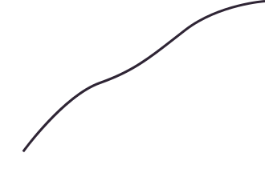

Project Report
DIABETES PREDICITON

Slide 2
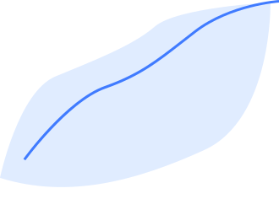

TABLE OF CONTENTS
Abstract
introduction
Existing Method
Proposed Method & Architecture
Methodology
Implementation
Conclusion

Slide 3


ABSTRACT
Diabetes has become a common disease to mankind from young to old people nowadays. There are various reasons due to which the population of diabetic patients is increasing day by day are obesity, bad diet, autoimmune reaction, change in lifestyle, eating habits, environmental pollution, etc.
Data analytics is one of the branches of computer science, which is a process of examining large datasets and find some useful hidden patterns and draw conclusions based upon those patterns.
This project presents a diabetes prediction system for the diagnosis of diabetes. Early detection of diabetes is possible with the help of this model.

Slide 4
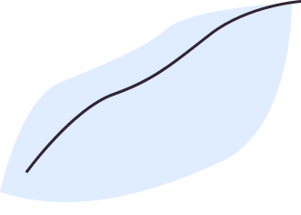

INTRODUCTION
Diabetes is brought about by the expansion level of the sugar (glucose) in the blood. Diabetes can be of two sorts, for example, type 1 diabetes and type 2 diabetes.
Type 1 diabetes can be found in kids and grown-ups at times.
Type 2 diabetes can be found in moderately aged individuals..
The serious issue which is executing a great many individuals all through the world is diabetes.
THE WORLD HEALTH ORGANIZATION (WHO)
THE SURVEY HAS FOUND THAT 1.2 MILLION PEOPLE
DIED DUE TO THIS CHRONIC DISEASE.

Slide 5
Different AI and deep learning calculations are utilized for some sort of forecast offices. Often these calculations are utilized by business giants for benefit in deals.
GIVEN THE SUBJECT HOW MIGHT WE UTILIZE INNOVATIONS FOR HUMAN ADVANCEMENT?
To learn the different complexities of different highlights of the biomechanics of the human body and foresee the entangled issues of individuals.
The machine must be prepared with the attitude of a specialist with different highlights and outer components gave from a valid dataset.

Slide 6


EXISTING METHODS
Initial glucose challenge test
A1c blood test
This usually occurs at 24–28 weeks of gestation
Also known as a glycated hemoglobin test.
Random blood sugar test
Examines your blood sugar at an unspecified time.
Fasting blood sugar test
Conducted after an overnight fast
Oral glucose tolerance test
Requires overnight fasting and then drinking a sugary liquid the next morning.

Slide 7
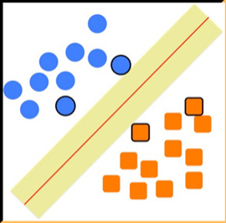
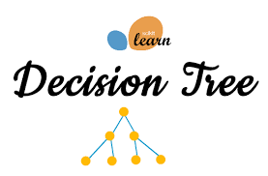

PROPOSED METHODS
This project uses the data provided by the user and runs classification machine learning models to detect the various correlations between the data and the probability of diabetes.
Support Vector Machine
Random Forest Classifier
Decision Tree Classifier
Effective in high dimensional spaces
It is usually robust to outliers and can handle them automatically.
Requires less effort for data preparation during pre?processing.

Slide 8
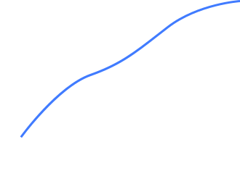

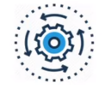
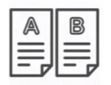
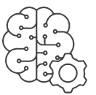



ARCHITECTURE
Fetching diagnosis data for diabetes patients and reports
Data Pre-processing
Splitting the Data into Train and Test
Training the Model
Calculating the Accuracy
Prediction

Slide 9

METHODOLOGY
IMPORTING THE DEPENDENCIES
DATA COLLECTION
DATA PREPROCESSING
SPLITTING THE DATASET INTO TRAIN AND TEST
importing the libraries such as pandas and numpy and our models
Importing the Dataset
FIlling inthe missing values
FIlling 0 values with mean
Standardisation of data
Creating xtrain, xtest, ytrain, ytest
TRAINIING THE MODELS
FINDING THE ACCURACY SCORE
PREDICITION
Using our trained model to predict on a new set of values
Importing the models and training them on the xtrain
Using the xtest to check the accuracy of the model

Slide 10

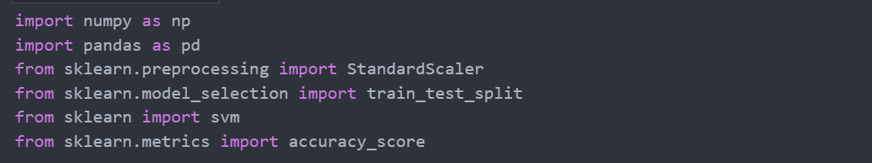
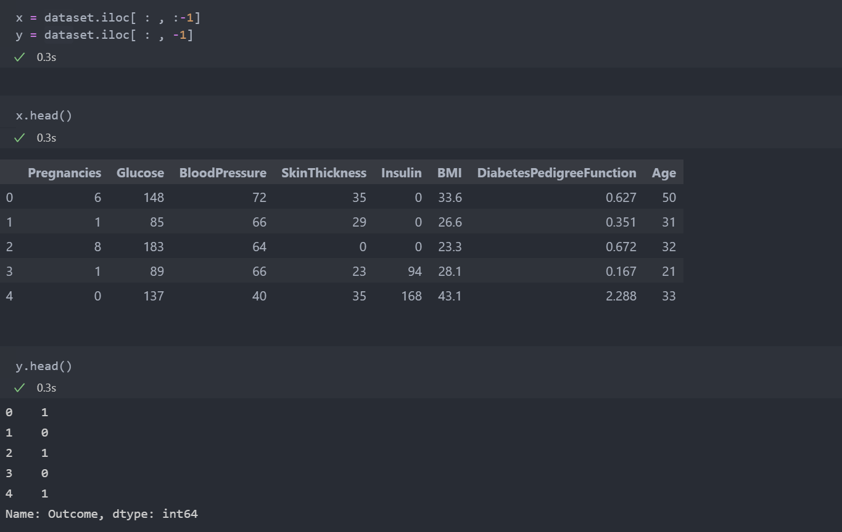
IMPLEMENTATION
Importing the dependencies
Data Collection

Slide 11
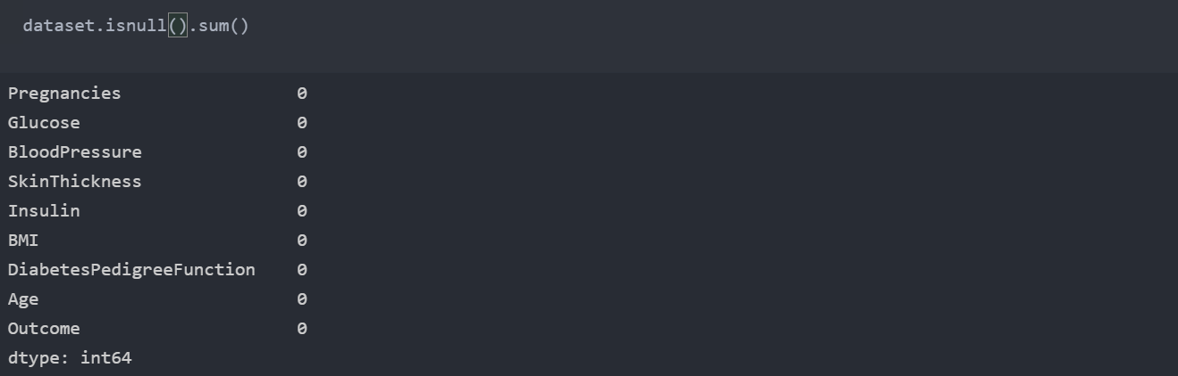
IMPLEMENTATION
Data Pre-processing
Checking for null values

Slide 12
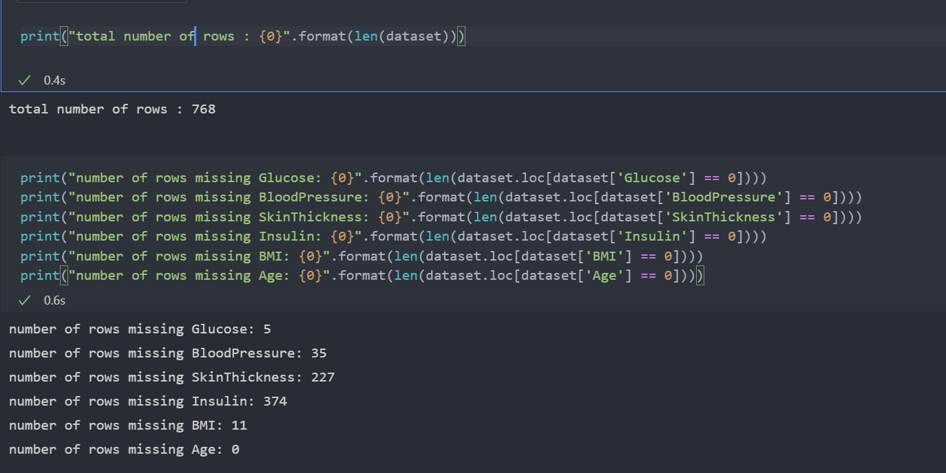
IMPLEMENTATION
Checking for 0 values

Slide 13
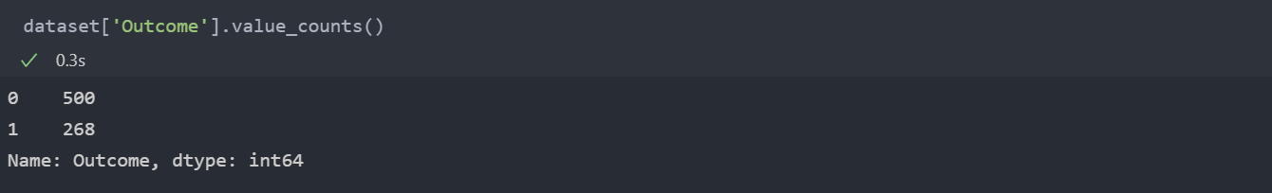
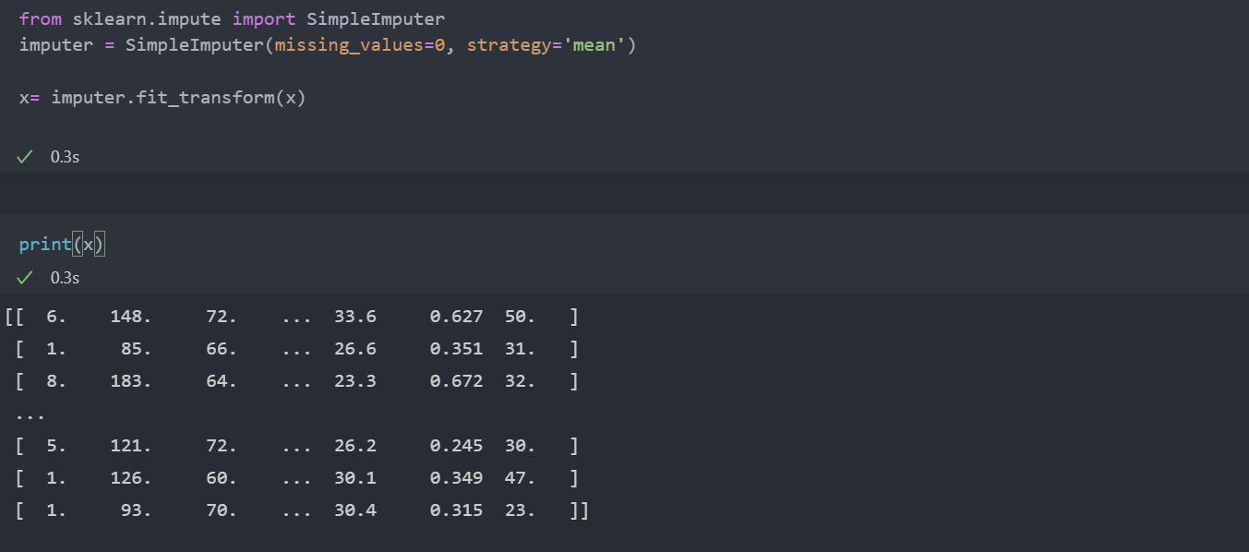
IMPLEMENTATION
Filling in 0 values with
mean values

Slide 14
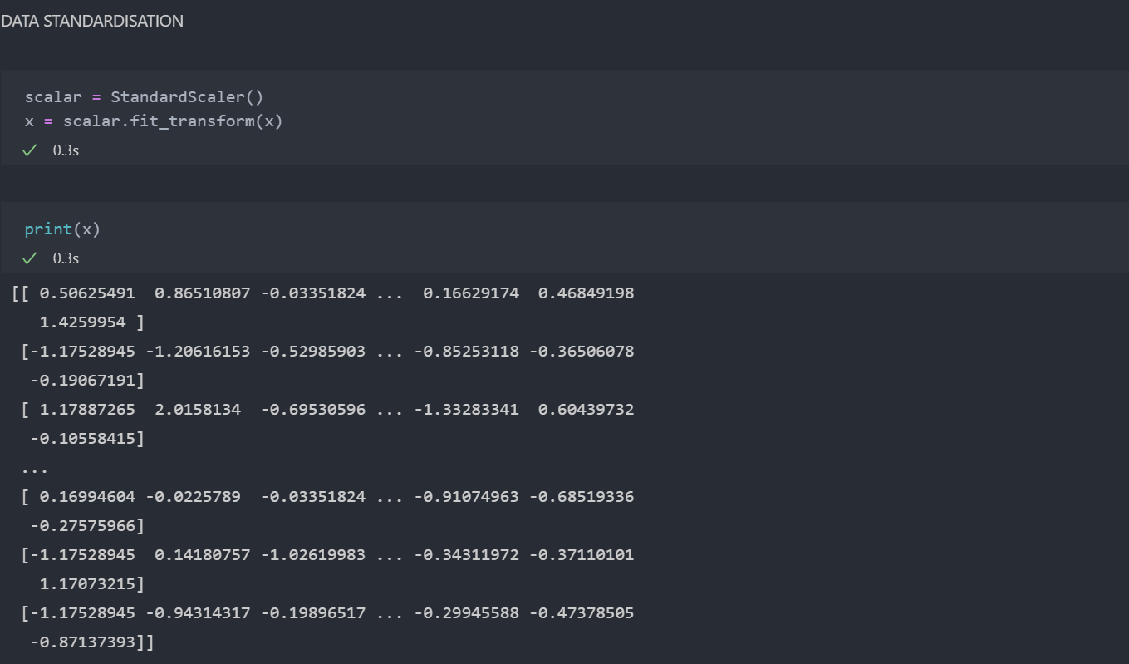
IMPLEMENTATION
Data Standardisation

Slide 15
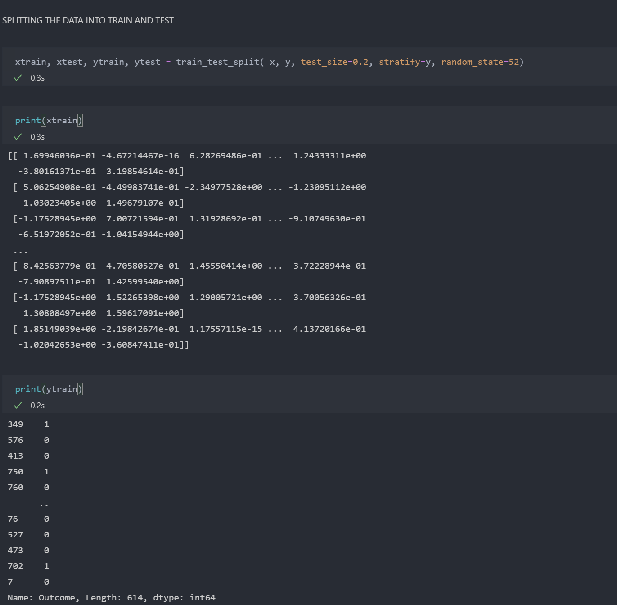
IMPLEMENTATION
Splitting the dataset into
train and test

Slide 16
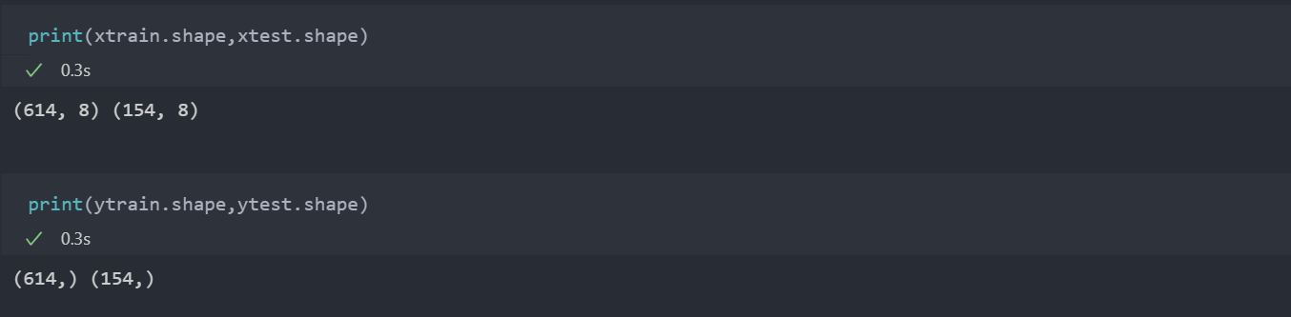
IMPLEMENTATION

Slide 17
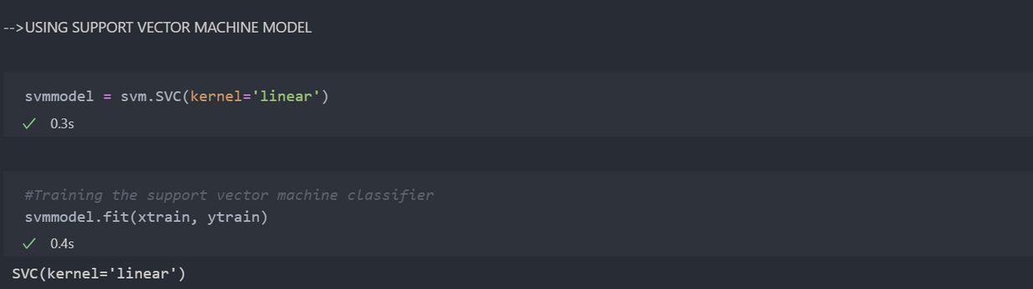
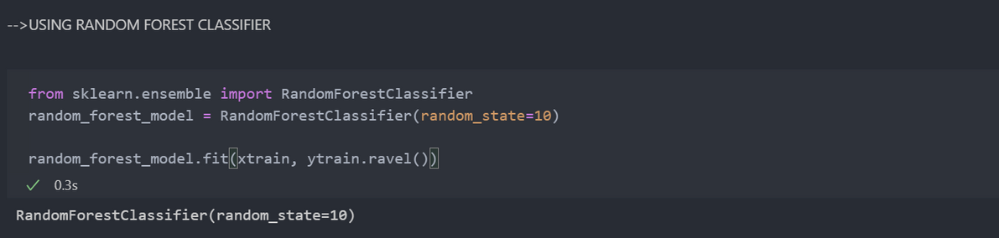
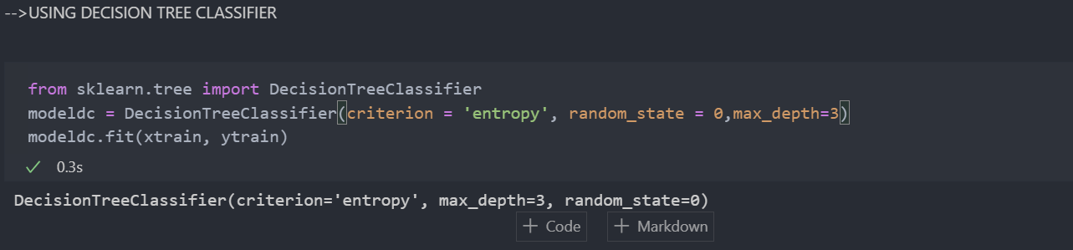
IMPLEMENTATION
Importing and
Training the models on xtrain

Slide 18
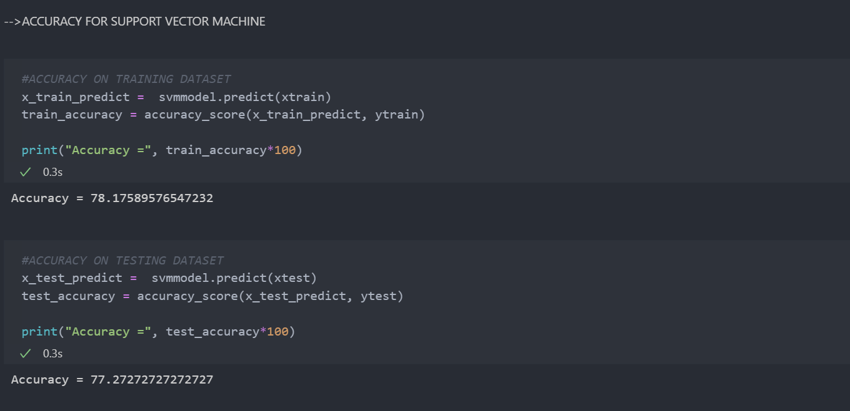
IMPLEMENTATION
Accuracy for Support Vector Machine
Classifier

Slide 19
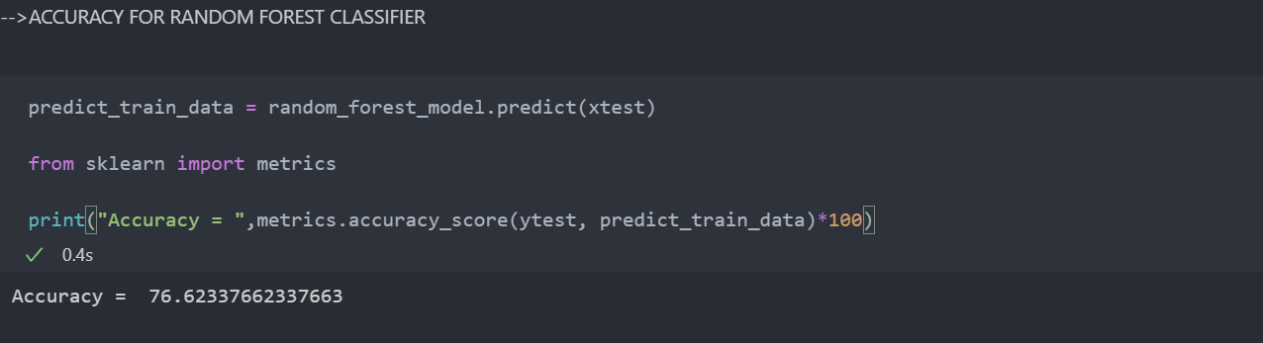
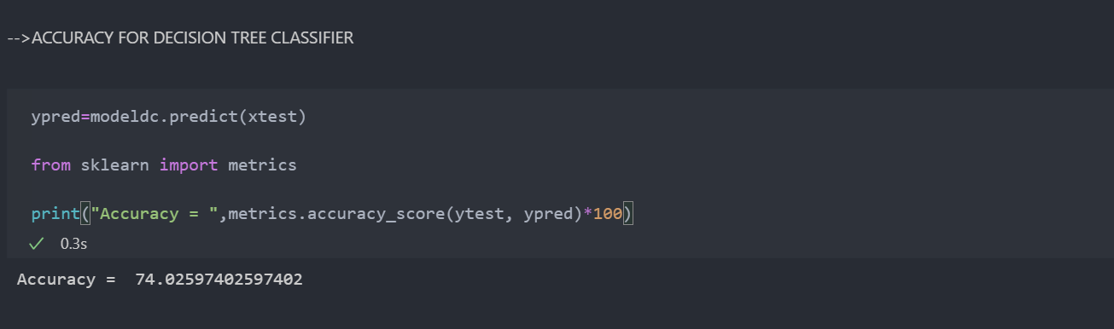
IMPLEMENTATION
Accuracy for Random Forest Classifier
Accuracy for Decision Tree
Classifier

Slide 20
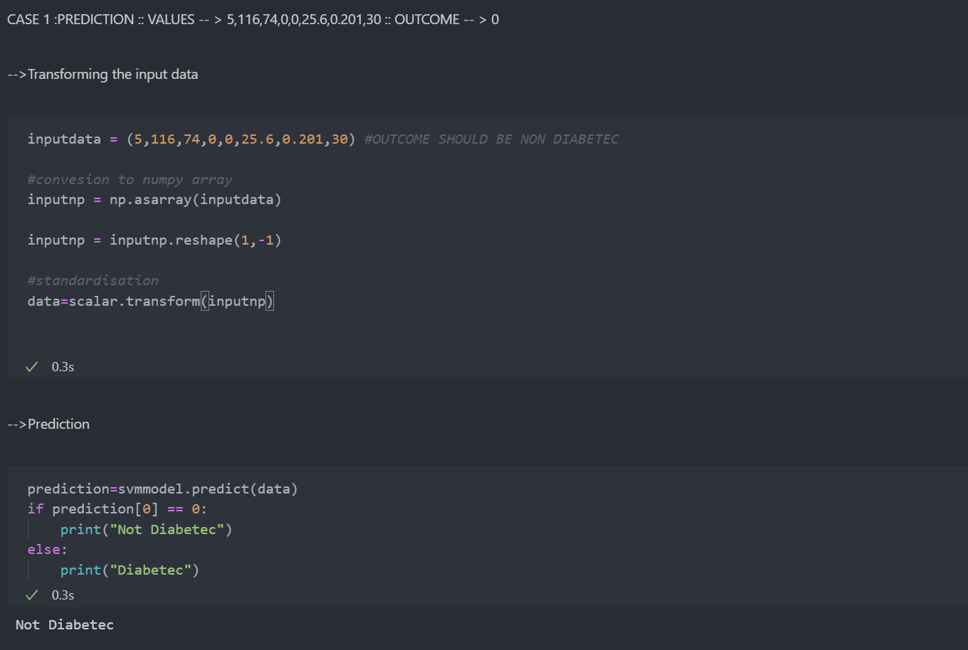
IMPLEMENTATION
Prediction :
CASE 1

Slide 21
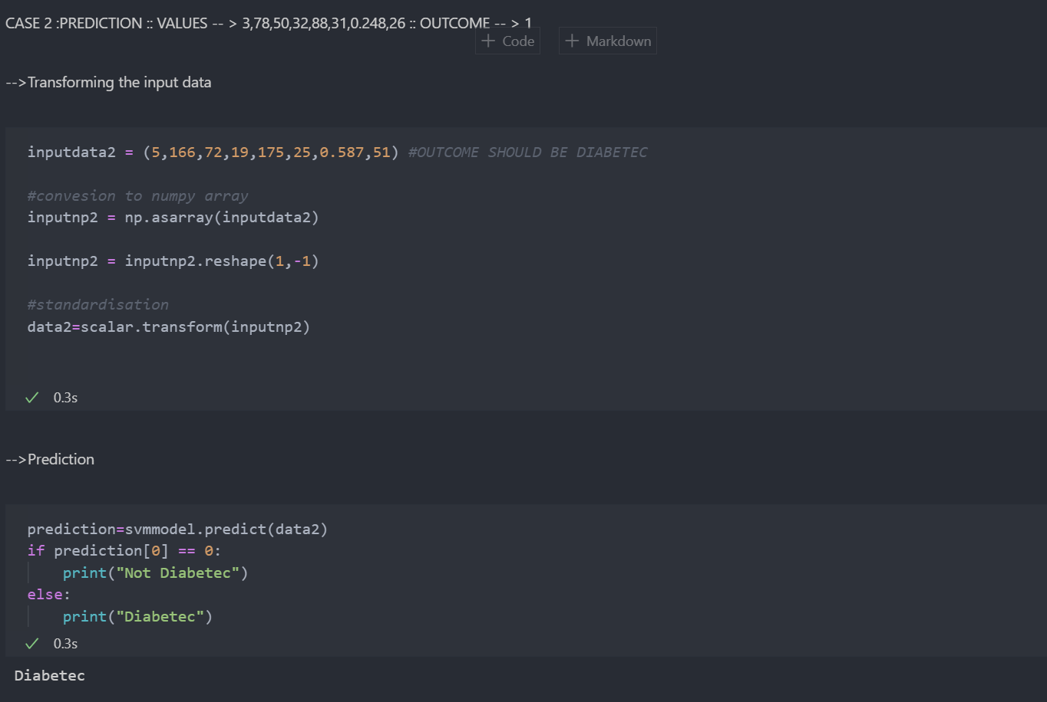
IMPLEMENTATION
Prediction :
CASE 2

Slide 22

CONCLUSION
Here we applied different Machine Learning techniques
to construct a diabetes classifier.Accomplished an accuracy score of 78 % through the use of Support Vector Machine Classifier.
PRESENTED BY:
MILIND DALAKOTI
Phone Number
9953653656
Email Address
milinddalakoti@gmail.com
LinkedIn
https://www.linkedin.com/in/milind-dalakoti/

